Slide 1
Agentic Document Processor
Multi-Agent AI Pipeline with LangGraph
Charan L
Project Intern — AI, Data & AI

Slide 2
Problem Statement
Problem:
Scope:
Need:
Enterprises handle large volumes of unstructured documents
Manual processing is slow, inconsistent, and error-prone
Single-model dependency introduces reliability risk
Weak validation and redaction increase compliance risk
End-to-end pipeline: classify → extract → validate → repair → redact → report
Unified handling of multiple document types in one workflow
Structured machine-readable outputs for downstream systems
Built-in quality checks and responsible-AI traceability
Reliability-first design with fallback execution strategy
Reduce manual effort and turnaround time
Improve extraction quality and consistency
Protect sensitive data through PII masking
Provide audit-ready processing transparency

Slide 3
Solution
This illustrates the robust 6-agent LangGraph workflow for end-to-end document processing.
Built a 6-agent LangGraph workflow
Agent flow: Classify → Extract → Validate → Self-Repair (conditional) → Redact → Report
Produces validated JSON, redacted content, metrics, and trace logs
Exposed through API and UI for practical usage

Slide 4
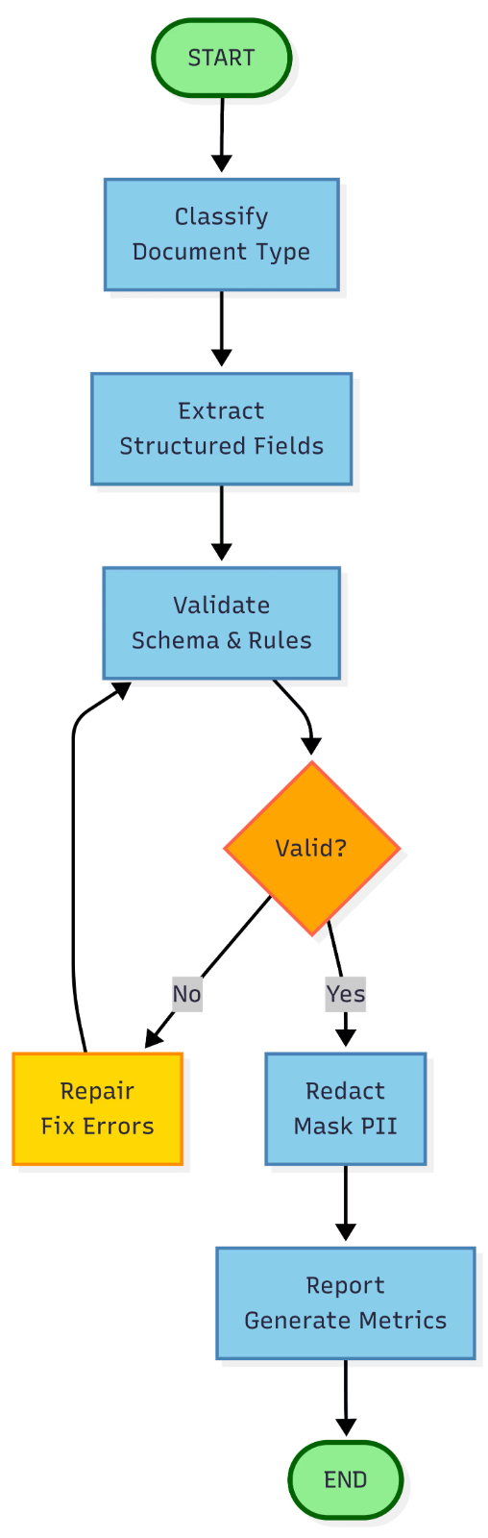
Architecture — What & Why
What:
Modular multi-agent architecture
Stateful orchestration
Conditional repair path
Fallback-based LLM execution chain
Why:
Higher reliability during provider failures
Better quality through validation + repair loop
Better compliance through redaction + trace logs
Easier maintenance and extensibility via modular agents

Slide 5
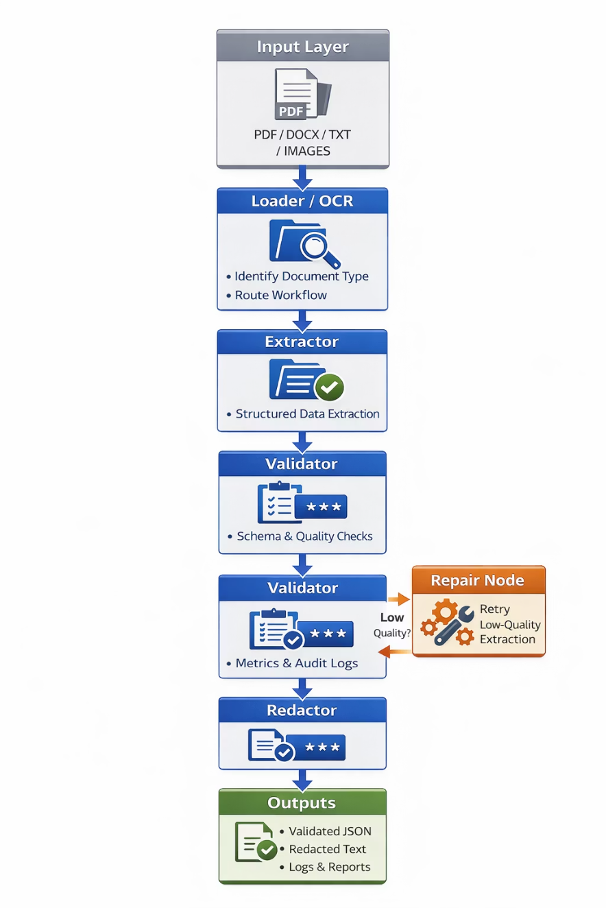
High-Level Workflow
Input document — accepts PDF, DOCX, TXT, image
Loader / OCR — extracts text; OCR used for scanned files
Classifier — identifies document type for routing
Extractor — converts content into structured fields
Validator — checks schema/rules and quality
Repair path (if needed) — retries low-quality extraction
Redactor — detects and masks sensitive PII
Reporter — compiles metrics and audit trace
Outputs — validated JSON, redacted text, logs, reports

Slide 6








Key Features
LangGraph-based stateful orchestration for dynamic and adaptive process flows.
Conditional self-repair mechanisms for handling and correcting low-quality outputs.
Schema-driven extraction and validation checks ensuring data integrity and accuracy.
Hybrid PII redaction approach to protect sensitive information securely.
Responsible-AI decision trace logging for transparency and accountability.
Multi-provider fallback for resilient and uninterrupted execution.
API + Streamlit interfaces providing flexible and user-friendly interaction.
Support path for OCR-based document processing to handle scanned files efficiently.

Slide 7
Evaluation / Performance
100.0%
93.4%
98.1%
94.6%
Classification Accuracy
Extraction Accuracy (avg)
PII Recall (aggregate)
PII Precision (aggregate)
100.0%
7.89s
Workflow Pass Rate
Latency
P95 12.99s
Evaluated on 28 documents across 6 document types, these key performance indicators highlight the system's efficiency and accuracy.

Slide 8
Future Scope
Batch + parallel document processing
Confidence-based human review workflow
Better OCR for noisy scans and table-heavy files
Domain-adapted extraction/validation templates
Latency optimization and caching strategy
Monitoring dashboards and failure/drift tracking
Policy-based redaction modes by use case
Production deployment hardening and controls

Slide 9
Thank You
Questions?

